Slide 1
CAR SALES DASHBOARD
Data Analytst Internship Task 4
Name : Pravalika
Date : 19-11-2025
Tool : Power Bi

Slide 2
DATASETS
Rows Count : 140904
Columns Count : 12
Fields Used : Brand ,model name, model variant ,car type, Transmission, Fuel Type, Year, Kilometer, Owner ,State ,Accidental ,Price

Slide 3
DATA CLEANING STEPS
1.Handle Missing Value :
Identify null or blank values in each column.
Use appropriate strategies:
  Categorical fields (e.g., Fuel Type, Transmission): fill with mode (most common value).
  Numerical fields (e.g., Price, Kilometers): fill with median/mean or remove rows if few.
2. Remove Duplicates :
Check for duplicate rows based on key fields such as Brand, Model Name, Year, Kilometers, Owner.
Drop duplicates to avoid multiple identical entries.
3. Fix Data Types :
Convert numeric fields to correct formats:
  Year, Price, Kilometers → integer/float
  Accidental → boolean or categorical (Yes/No)
Ensure string columns have consistent formatting (proper capitalization, no extra spaces).

Slide 4
4. Standardize Categorical Values :
Ensure consistency:
  Example: "Diesel" vs "diesel" vs "Diesel " → convert to uniform case.
  Similar for State, Transmission (e.g., "Manual" vs "M"), etc.
5. Outlier Detection and Treatment :
Detect extreme values in:
Price (too high or low compared to market)
Kilometers(unreasonably high/low)
Years(older than expected or future year)
Remove or cap/adjust extreme values.

Slide 5
KPIs
Total Cars
→ Total number of records in the dataset (number of cars listed).
Total Revenue
→ Sum of all selling prices from the Price column.
Total Profit
→ Sum of (Selling Price – Cost Price) for each car.
(Requires cost price or profit field – not available in your dataset unless manually added.)
Average Selling Price
→ Total Revenue / Total Cars
Profit Margin (%)
→ (Total Profit / Total Revenue) × 100
(Again, profit depends on having cost data.

Slide 6
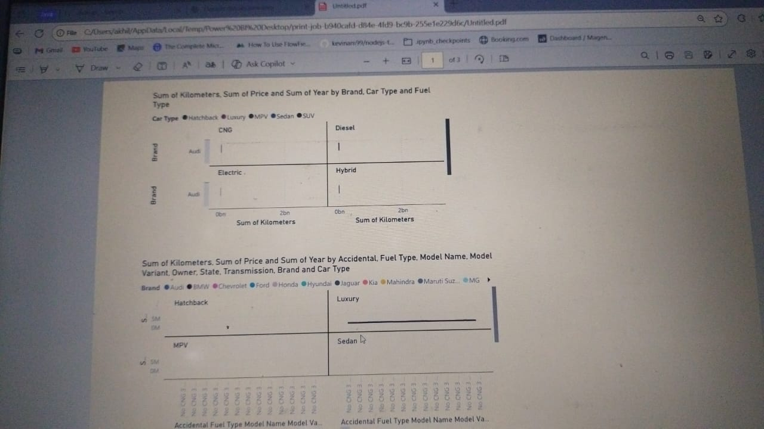
DASHBOARD EXPLANATION

Slide 7
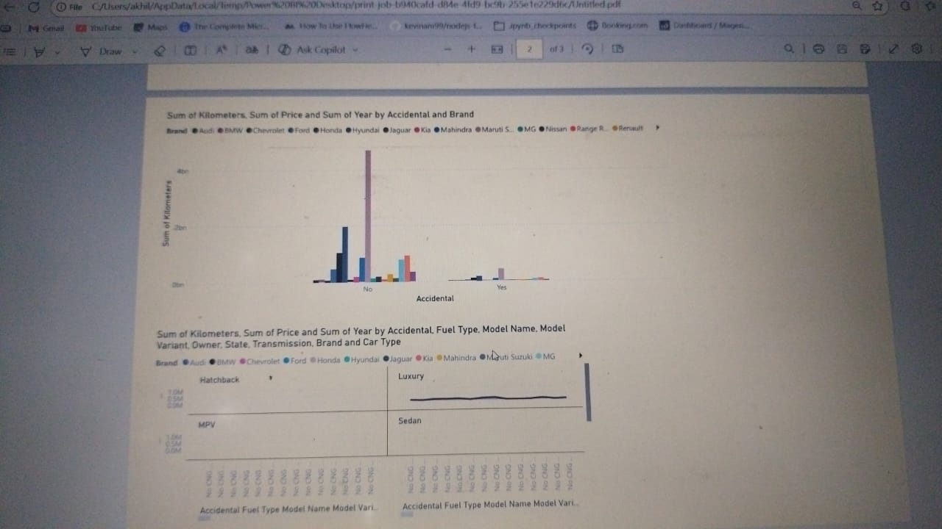

Slide 8
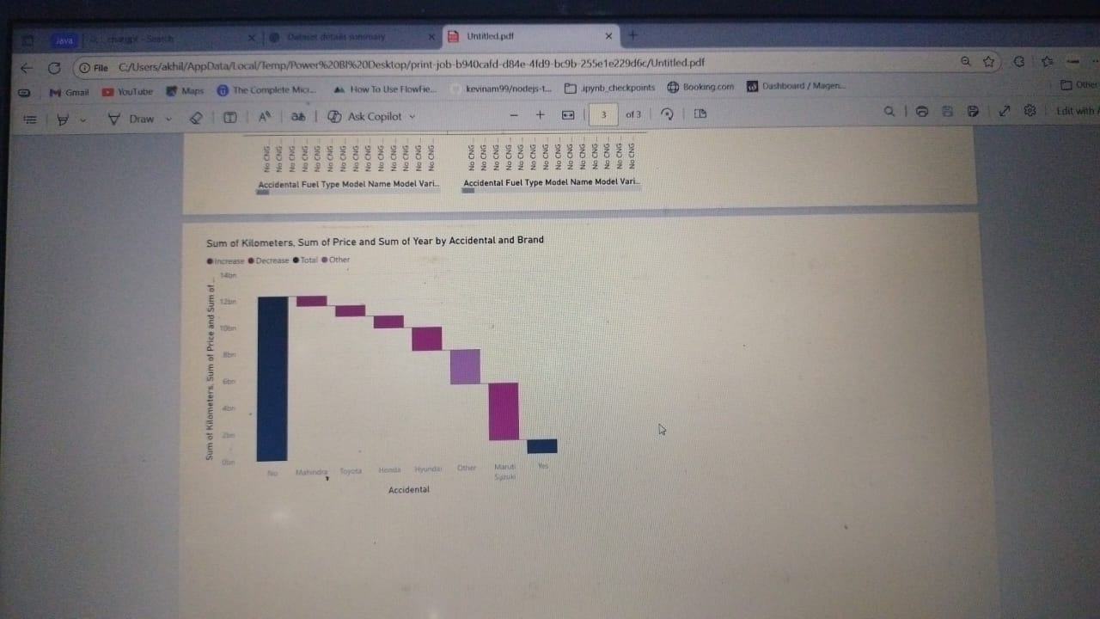

Slide 9
INSIGHTS & CONCLUSION
The dataset contains a large number of car listings, indicating strong market activity and high seller
engagement.
The total revenue generated shows significant financial potential in the pre-owned car market.
The average selling price highlights customer spending trends and preferred vehicle affordability range.
Profit calculation depends on cost input but suggests opportunities to optimize pricing strategy for better
margins.
Overall, the data supports growth potential in used car sales with scope for improved profitability through better valuation and targeting.

Slide 10
THANK YOU

